Slide 1

Basic statistics
August 2025

Slide 2
Contents
Measurement
Mean values
Deviations
Least squares method
Ax = b

Slide 3
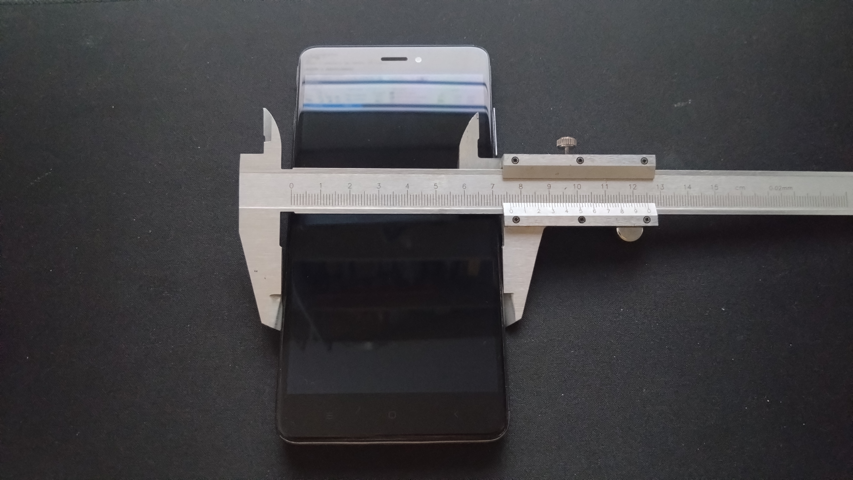
1. Measurement

Slide 4
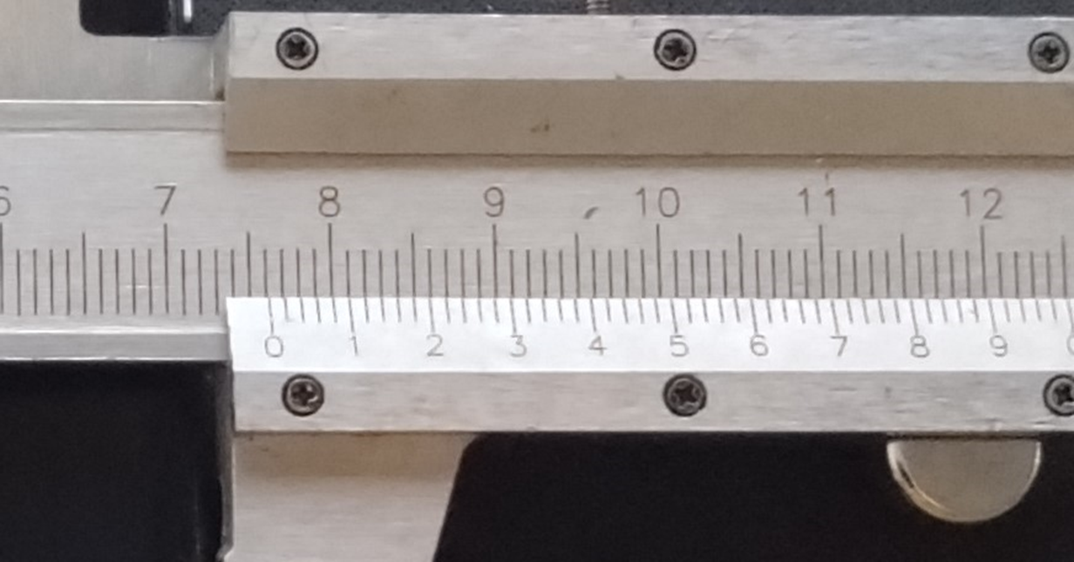
1. Measurement
Which one is it?
7.610
7.612 7.614 7.616

Slide 5
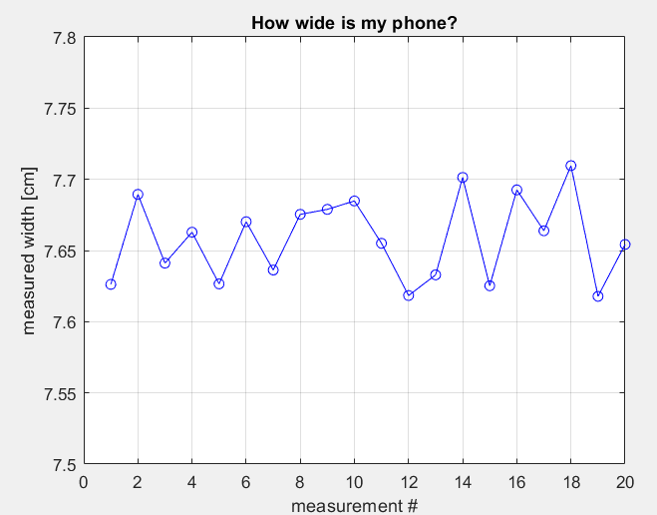
2. Mean values

Slide 6
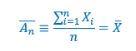
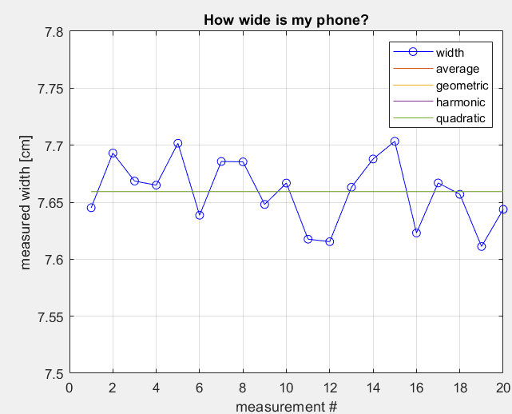
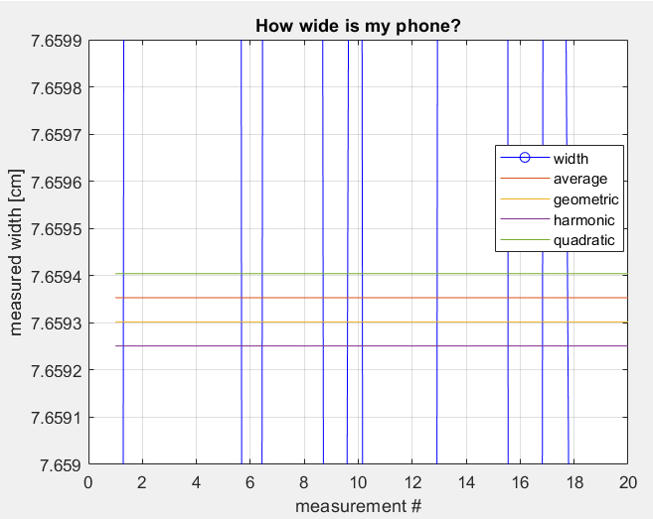
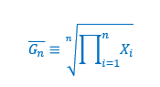
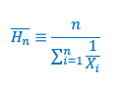
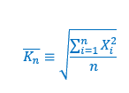
2. Mean values
1. Mean average 2. Mean geometric
3. Mean harmonic
4. Mean quadratic

Slide 7
2. Mean values
Mean Type | Best Use Case | Example Scenario
Arithmetic Mean | When values contribute additively | Average height, average income
Geometric Mean | When values combine multiplicatively, growth rates | Average interest rate, population growth
Harmonic Mean | When averaging rates, especially over fixed quantities | Average speed over equal distances, price per unit
Quadratic Mean (Root Mean Square, RMS) | When measuring energy, signal strength, or magnitudes | RMS voltage, error energy in least squares fitting

Slide 8
2. Mean values
Q: How wide is my phone?
A: Arithmetic mean = 7.613 [cm]
More intuition: Arithmetic: Assumes all differences between values are equally important.
Geometric: Emphasizes proportional changes. A good average for growth over time.
Harmonic: Gives more weight to smaller numbers. Great when smaller values dominate the outcome.
Quadratic: Punishes large values more — often used in physics, engineering, and regression to capture overall magnitude

Slide 9
3. Deviations
What about measurement accuracy?
How close are we to the real value?
How much is the data spread out?

Slide 10
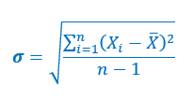
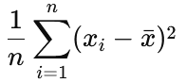
3. Deviations
The answer to these questions is the introduction of variance σ² (and standard deviation σ):
Variance =
Why the
-1 ?

Slide 11
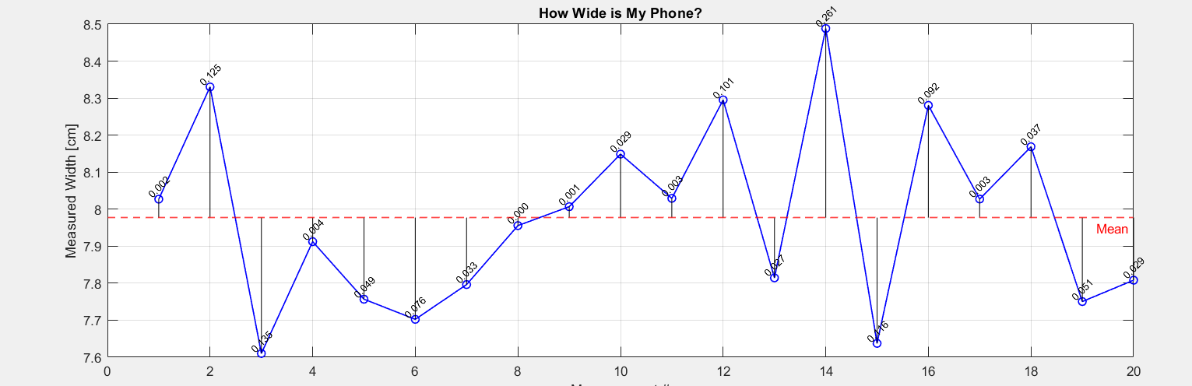
3. Deviations

Slide 12
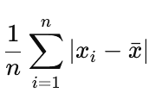
3. Deviations
Q: Why use variance? Why don’t we use something like the absolute difference: It does the following:
Measures distance to mean
Takes into account all points
Is similar to the variance formula
So why aren’t we using it?

Slide 13
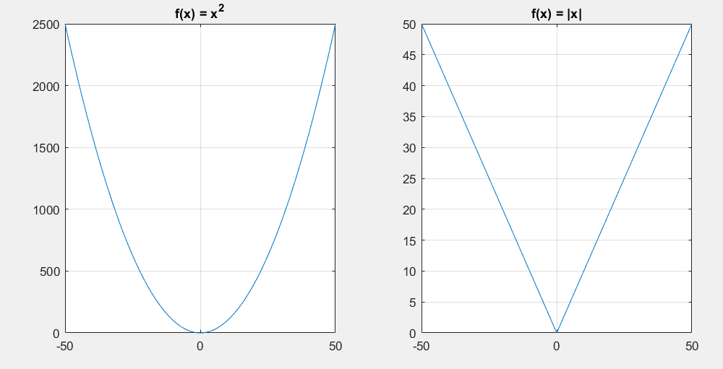
3. Deviations
A: 1. the quadratic function is continuous 2. it is differentiable at x=0 3. abs() is not so sensitive
4. The quadratic comes up more later in distributions and methods (LSM)

Slide 14
4. Least squares
So far we have went over what the mean and the standard deviation is. They provide good descriptive values to our sample. One gives the most likely (average) outcome. The other shows us how far from that average we expect to measure (or see) a new value.
Q: What else can we do with them?

Slide 15
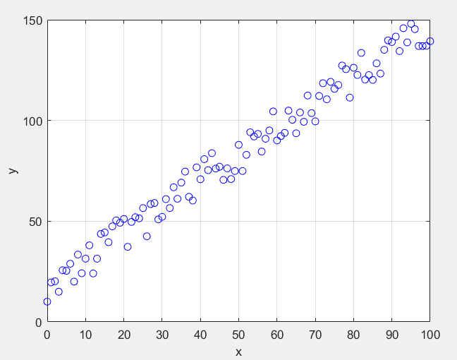
4. Least squares
Suppose we are measuring something, and we get this graph:
It looks like a noisy line equation: y = ax+b But where do we draw the line (choose a and b)?

Slide 16
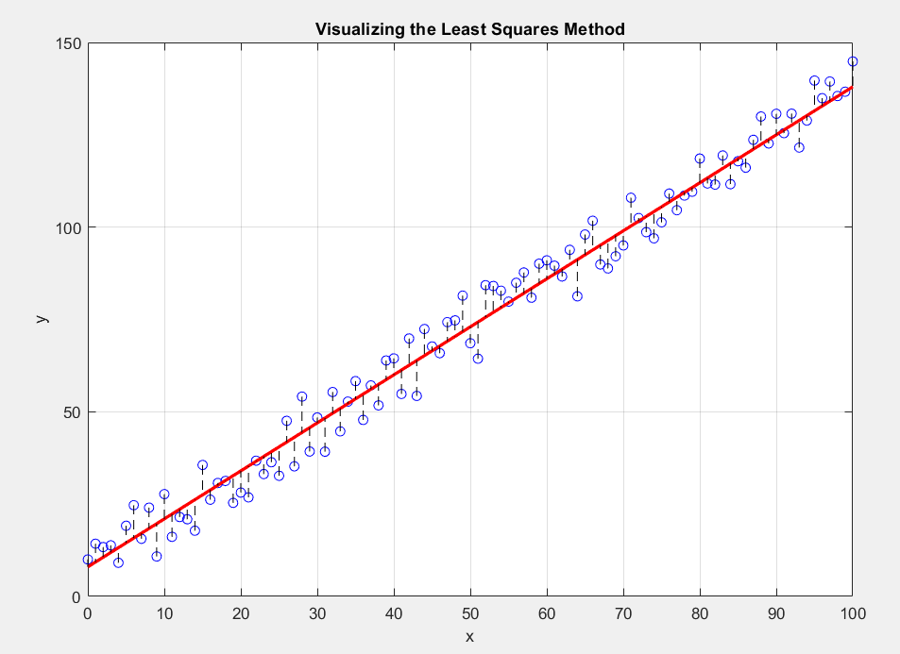
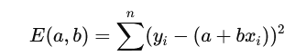
4. Least squares
Q: How do we draw the line? A: We choose a and b, so that the total distance between points and model is smallest.
This is the total distance (or total error):
It is the sum of “variances”

Slide 17
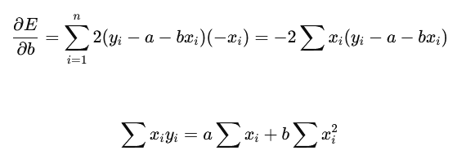
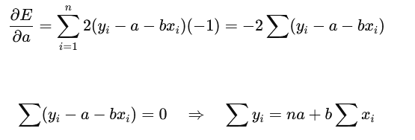
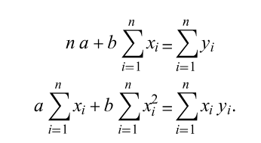
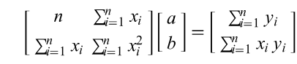
4. Least squares
Set to zero
Set to zero
Combine:
Matrix form:

Slide 18
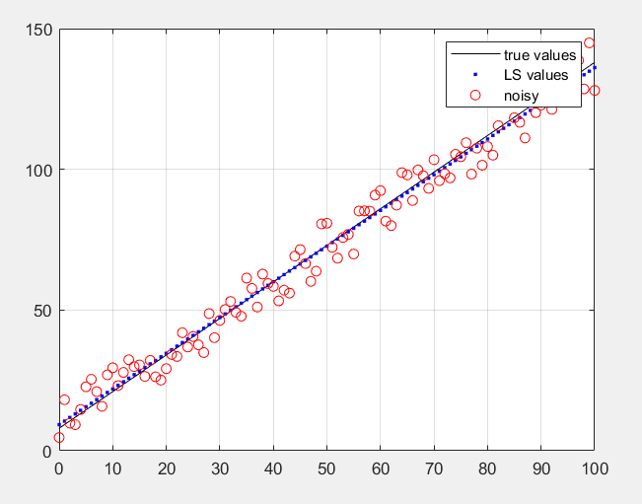
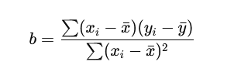
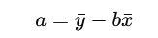
4. Least squares
Finally:
In our example: a_true = 1.3
b_true = 8.0
A_lsq = 1.3163
B_lsq = 7.9141

Slide 19
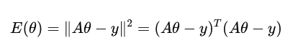
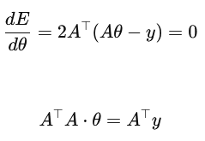
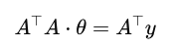
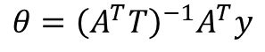
5. Ax = b
Let’s take a look at this again:
Minimization problem:
Matrix form:
We can redefine it as: A⋅θ = y
Transpose to get rectangular matrices:
$$θ={\left(A^{T}T\right)}^{−1}A^{T}y$$

Slide 20
Homework
1. See which matrices are invertible and when.
2. Checkout Tikhonov regularization - > when is it applicable?
3. Check out different methods for solving such equations (Gaussian Elimination, LU Decomposition, QR Decomposition, Cholesky Decomposition, SVD)
4. When are they applicable, based on:
Matrix size
Matrix structure (diagonal, tridiagonal, sparse)
Other considerations
5. Full code: Good book on the topic, chapter 2:

